Slide 1
Vessel Study Updates
July 26, 2024

Slide 2
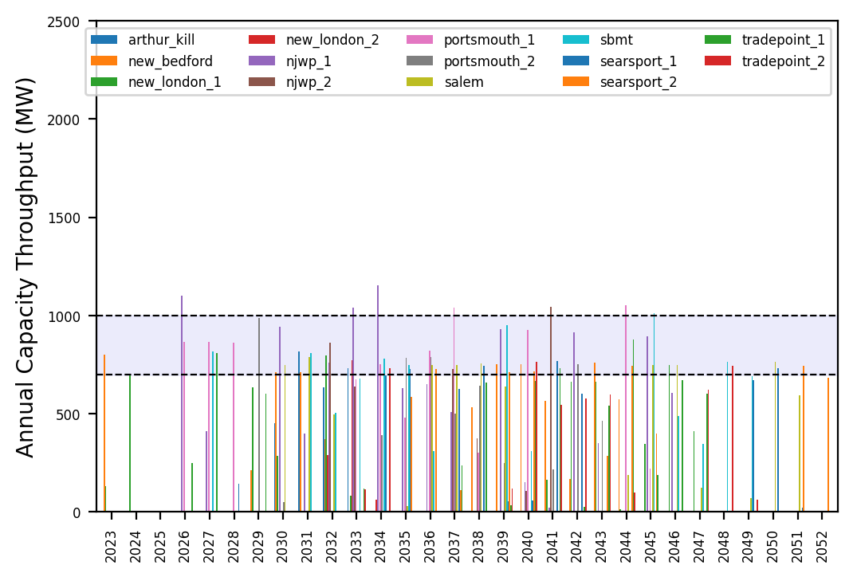
Port Throughput Update

Slide 3
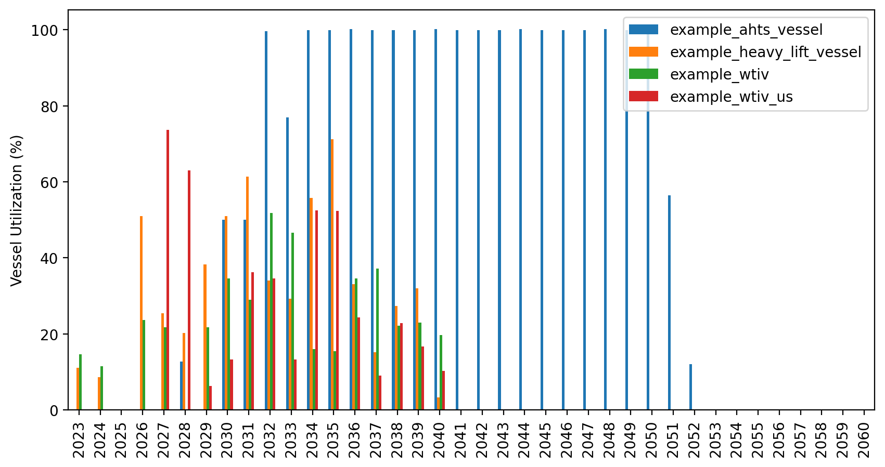
Vessel Utilization Update

Slide 4
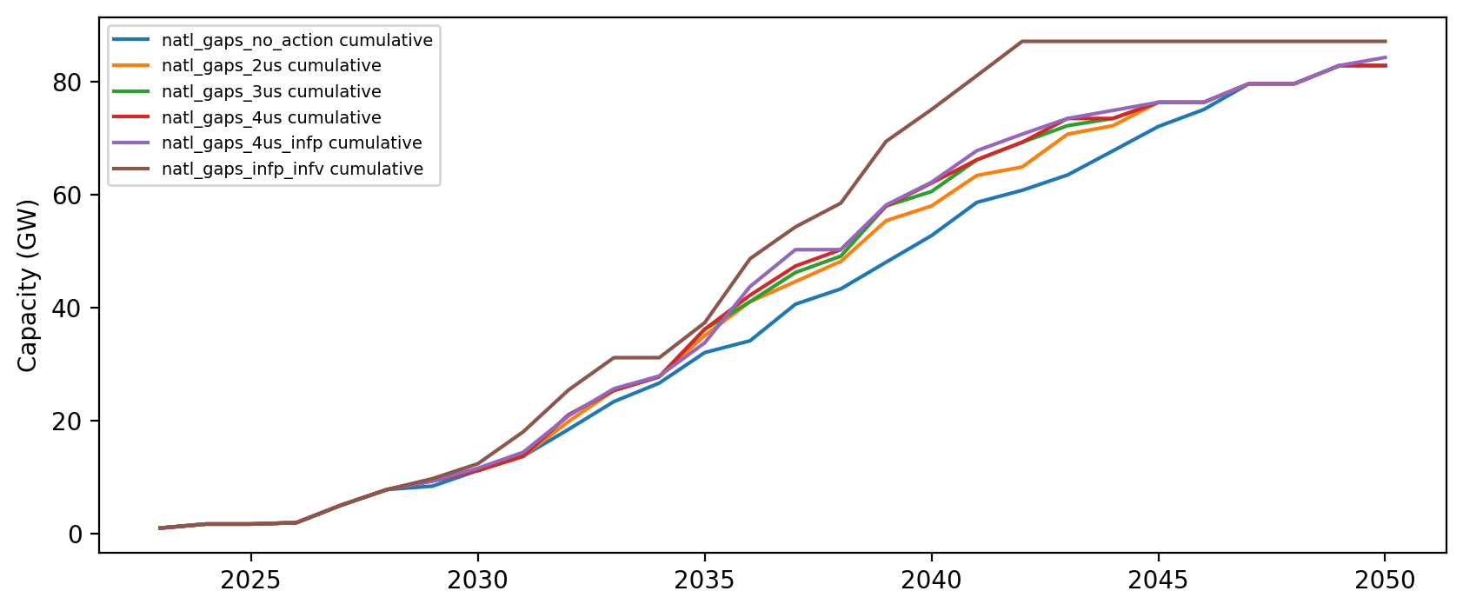
US WTIV

Slide 5
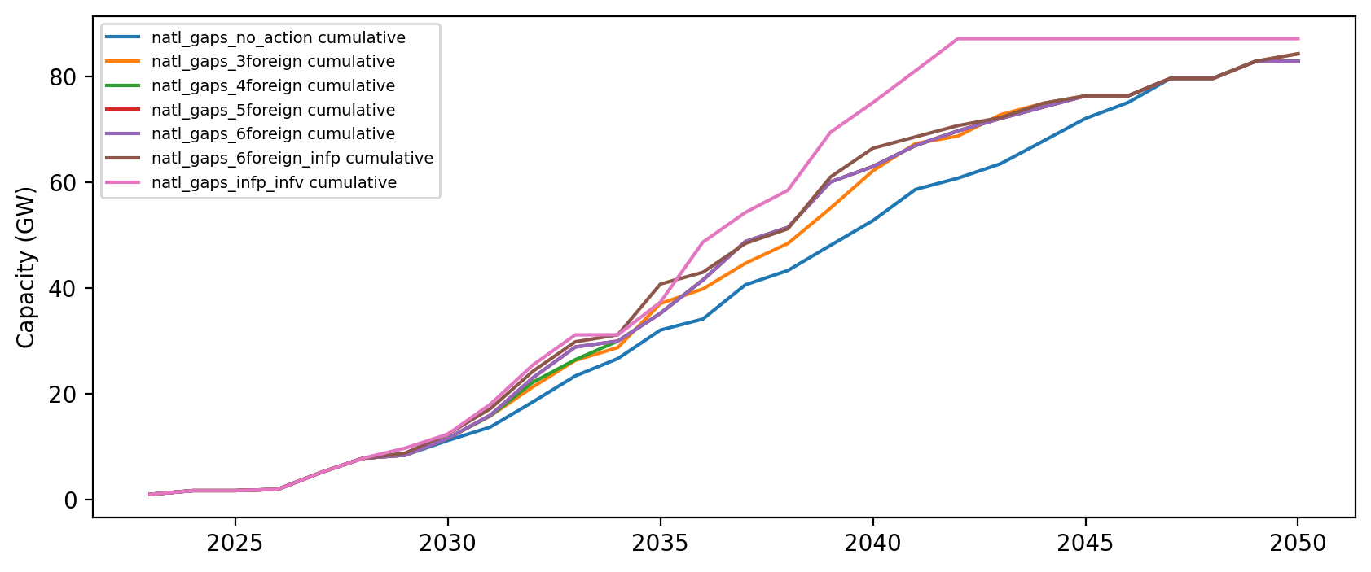
US Feeder

Slide 6
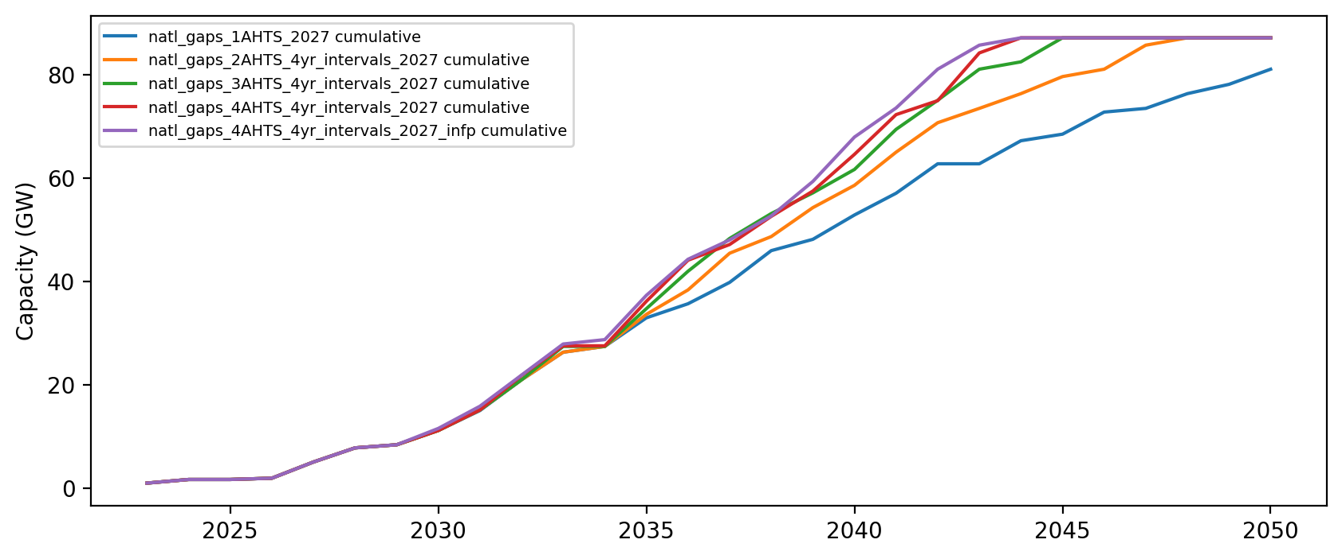
AHTS

Slide 7
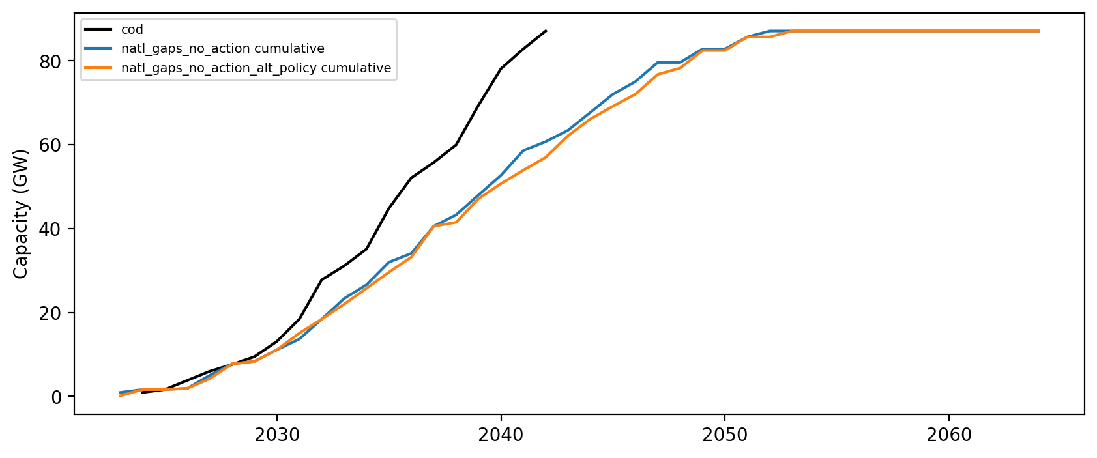
Alternate Jones Act Interpretation

Slide 8
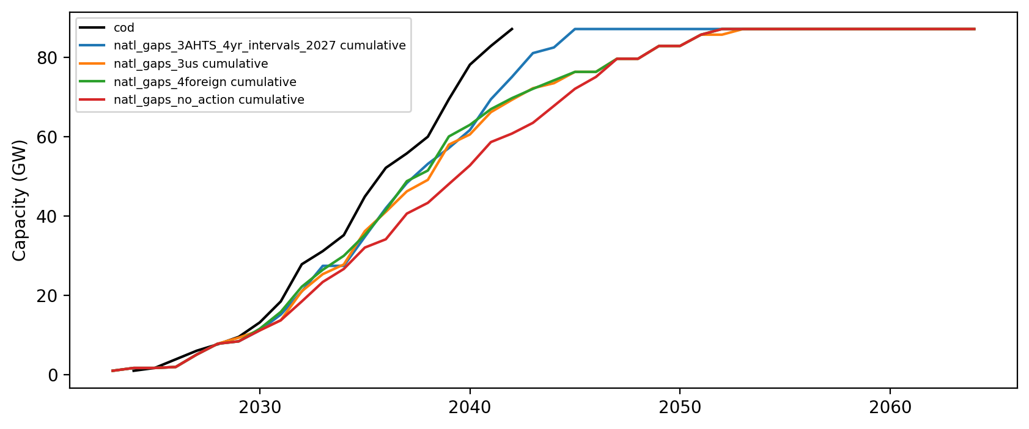
Summary Stats – Installed Capacity

Slide 9
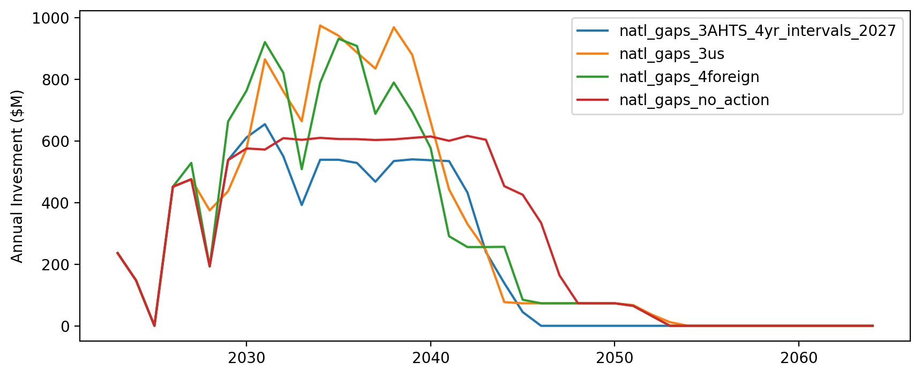
Summary Stats – Annual Vessel Investment

Slide 10
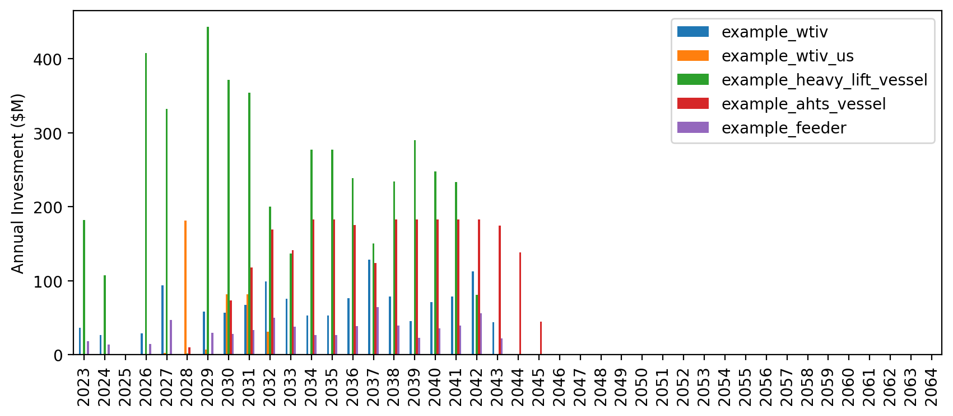
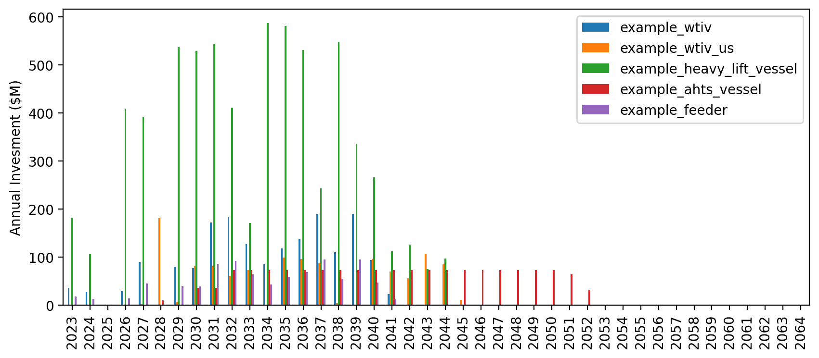
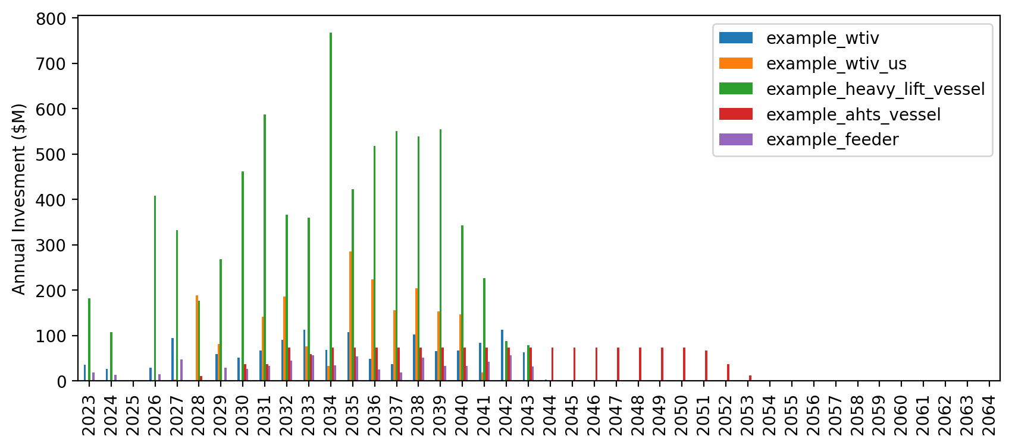
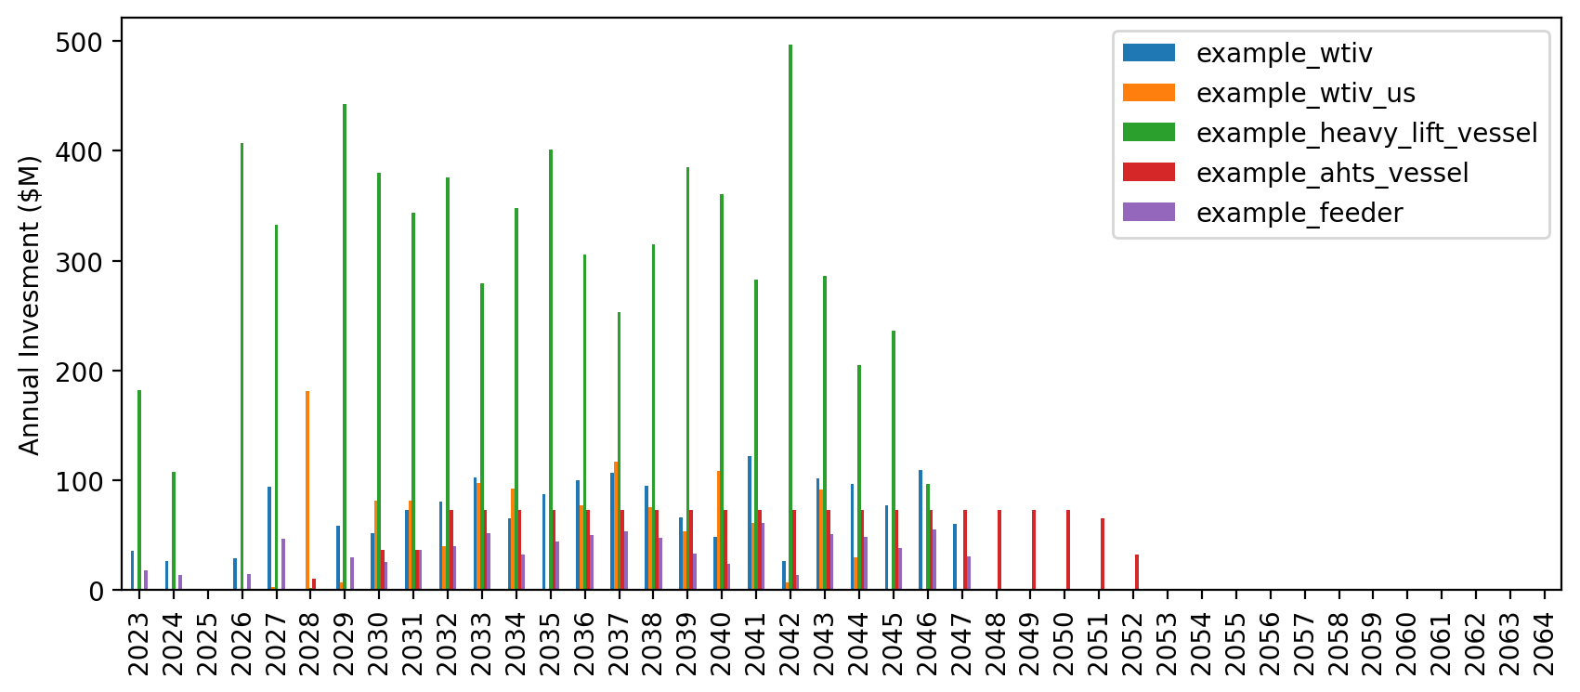
Summary Stats – Annual Vessel Investment Breakdown
AHTS
US Feeder
US WTIV
No Action

Slide 11
Summary Stats – Cumulative Vessel Investment

